Slide 1
Password
Generator
Student ID：202239627
YUAN HAOCHENG

Slide 2
CONTENTS
01
02
Requirement Analysis
System
Design
03
04
Last
modified
Project
Outcomes

Slide 3
PART ONE
01
Requirement Analysis

Slide 4
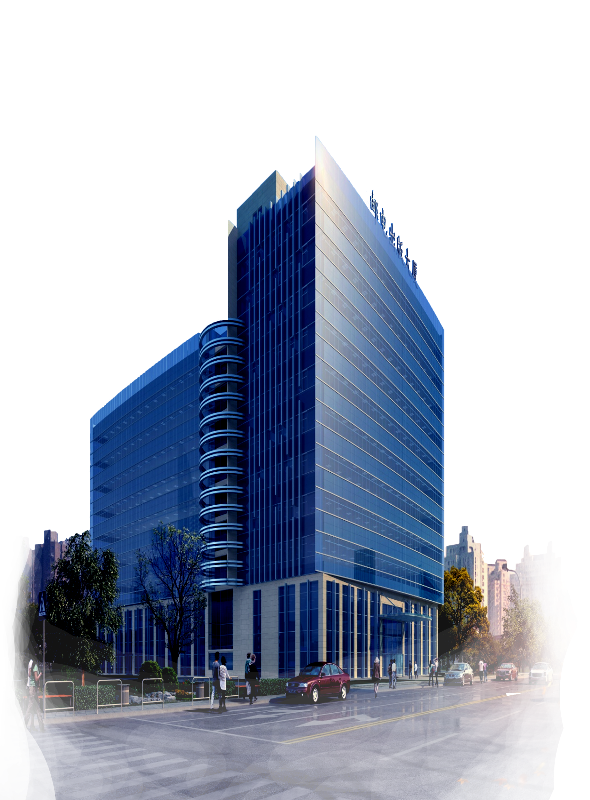

Get requirements
Goal: Help users quickly generate a random password
Functional requirements
What need we do?
result
User needs a password generator that includes different character types.
Quickly discuss or determine requirements, make a basic template, and wait for users to make comments and modifications
Input: Get password length and composition.
Output: Display the generated password to the user

Slide 5
PART TWO
02
System
Design

Slide 6


System Design
Implement this program in Python.
Function
Use random library to generate passwords.
Supports a mixture of uppercase letters, lowercase letters, numbers, and special characters

Slide 7
PART THREE
03
Project Outcomes

Slide 8
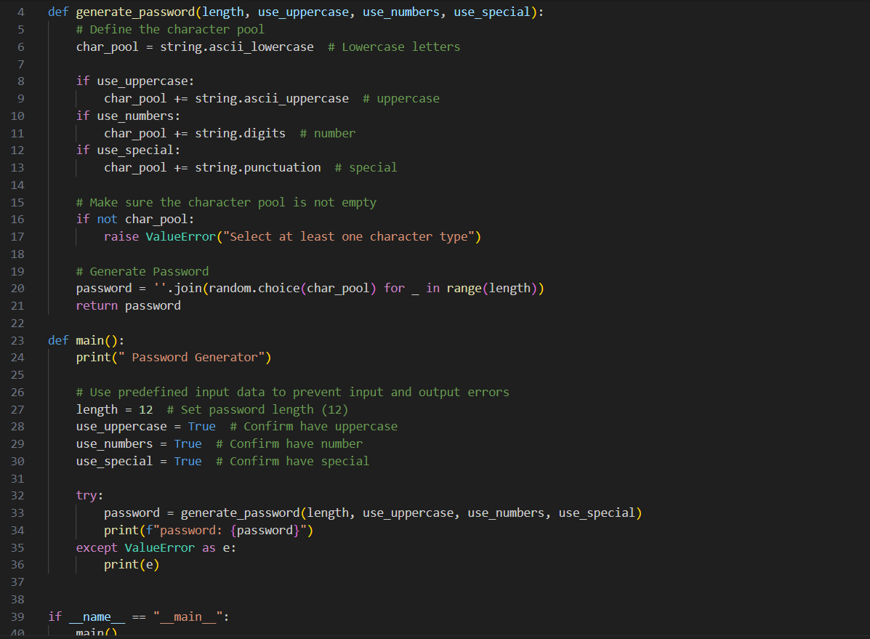
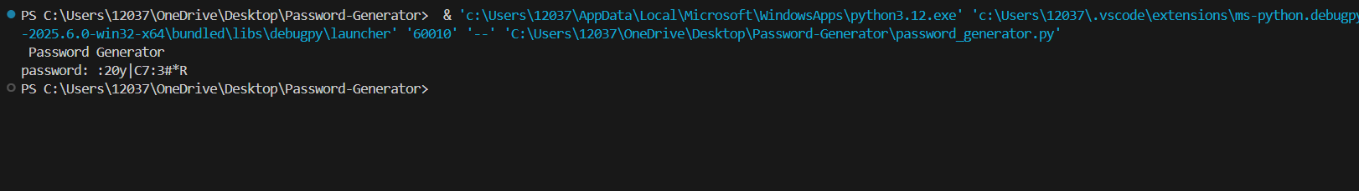
Code
OUTPUT:

Slide 9
PART FOUR
04
Last
modified

Slide 10
Last modified
Function
After a brief project demonstration, the user asked to add functions such as custom character count, uppercase and lowercase selection, etc.
Project Display
User comments
Final Project

Slide 11
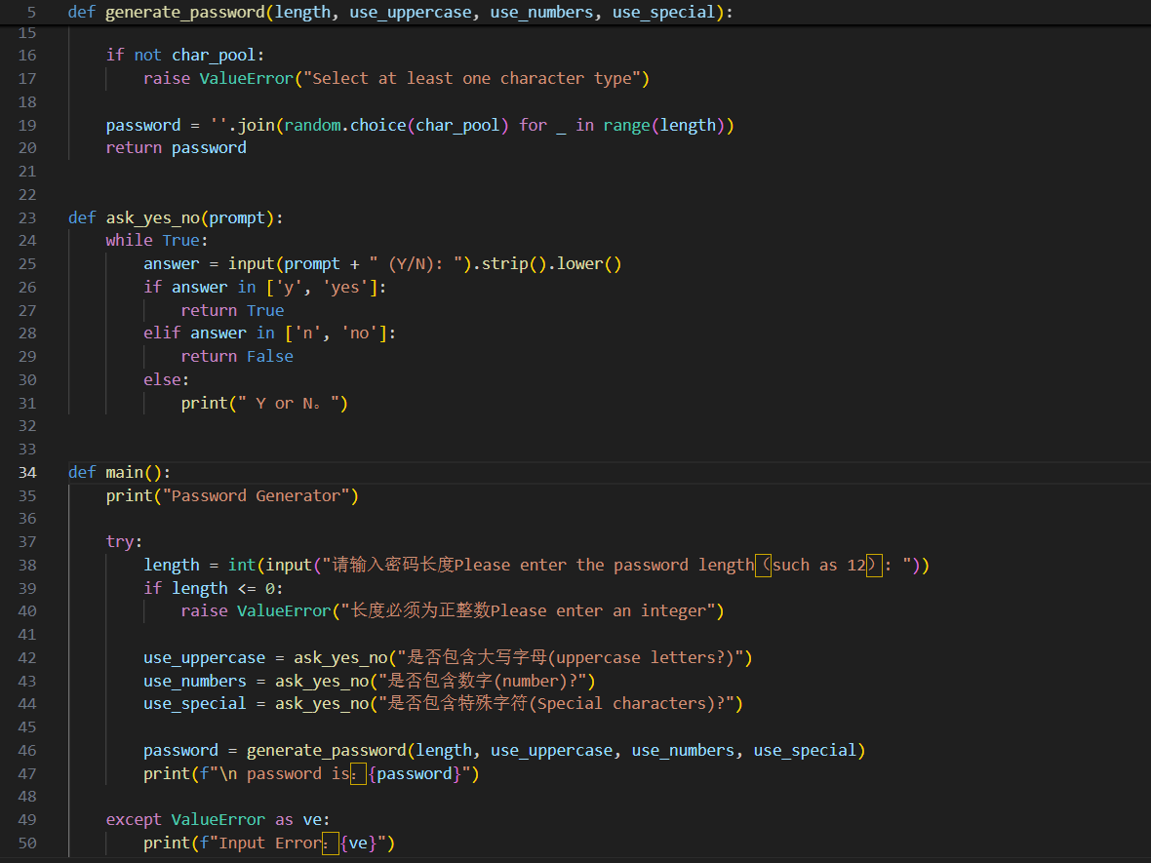
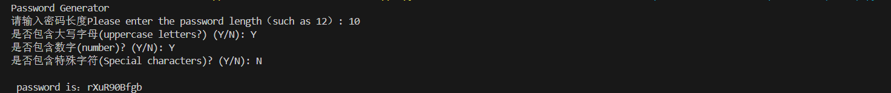
Code
OUTPUT:

Slide 12
THANKS
Q＆A
Github:
https://github.com/sgyhczbsn/Password-Generator

